Slide 1
Project: A study of time series process for estimating the product selling
PresentED by
Thanapol Punjarojanakul 6005700

Slide 2
Objectives

Slide 3

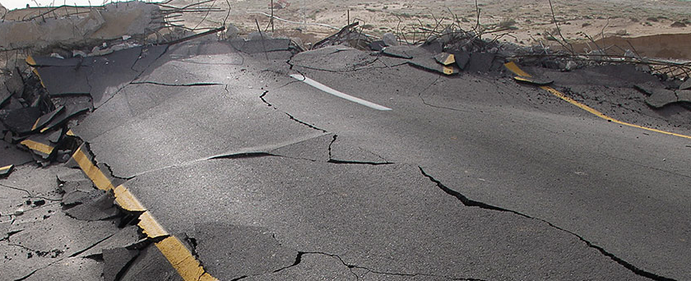

Examples
Forecasting how disease process
Predicting how frequency of earthquake
Predicting consumer electricity energy demand

Slide 4
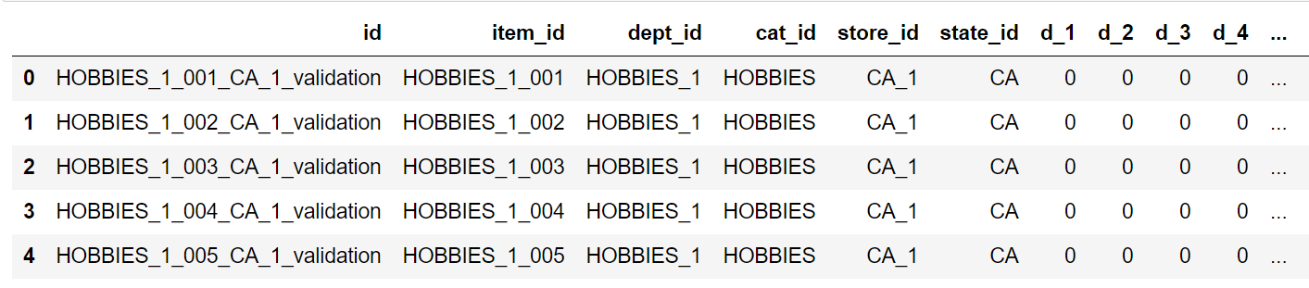
Preparing Data
(Raw data)

Slide 5
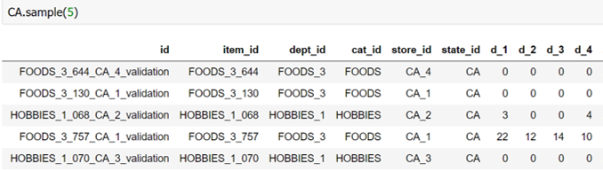
Preparing Data
(Raw data of[ state_id = CA])

Slide 6
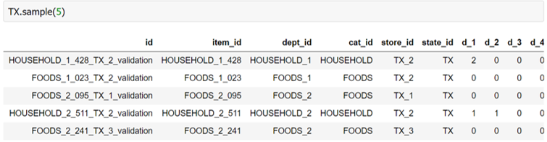
Preparing Data
(Raw data of[ state_id = TX])

Slide 7
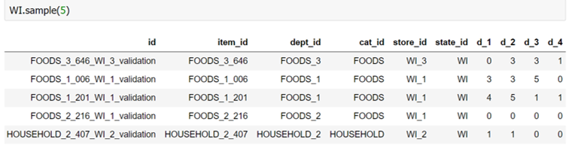
Preparing Data
(Raw data of[ state_id = WI])

Slide 8
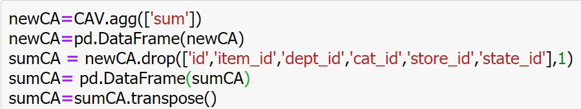
Preparing Data
After we separate data next we will combine the quantity of all of item to see the sales and we will drop the columns that we don’t use and transpose data to make it same row at the ‘dates’ in the ‘calendar.csv’

Slide 9
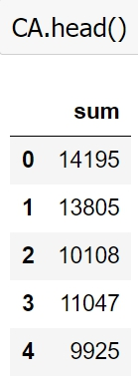
Preparing Data
(Raw Data separate only CA)

Slide 10
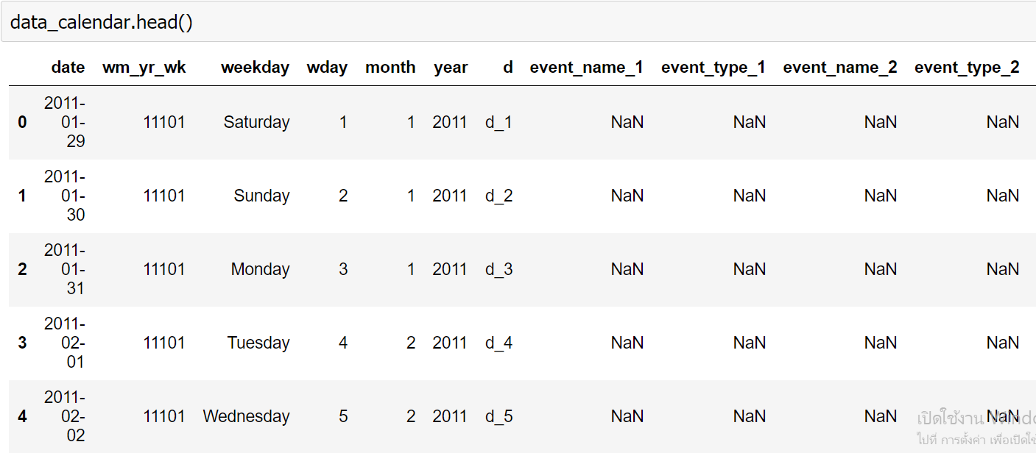
Preparing Data
Link the quantity sales data to the ‘calendar.csv’ to show the day that of the dates.
(Raw data Calendar)

Slide 11
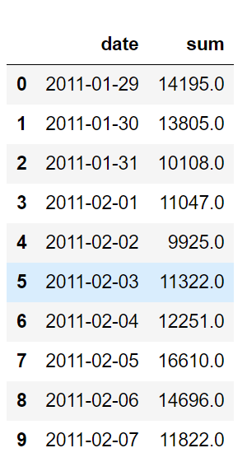
Preparing Data
(DataFrame after merge)
After merge data we will gain the data of quantity item sales and the dates in the same file.

Slide 12
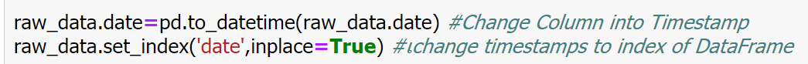
Preparing Data
Change the column ‘Date’ in to timestamps
(Make Date in to Timestamps data)

Slide 13
AR(Auto Regressive) Model

Slide 14

AR(1) or first order AR Model be like:
$$y_{t}=c+∅_{1}y_{t−1}+ ∈_{t}$$
$y_{t}=The value of time series at time t$
$$a_{1}=the autoregressive coefficient at lag one$$
$y_{t−1}=The value of time series at previous step$
$∈_{t}$ = shock term, the shock term is white noise(time series that show no autocorrelation), meaning each shock is random not related to the other shocks in the series.
C = constant
For an AR(1) model:
When $∅_{1}=0$, $y_{t}$ is equivalent to white noise;
When $∅_{1}=1$ and c = 0, $y_{t}$ is equivalent to a random walk
When $∅_{1}=1$ and c $≠$ 0, $y_{t}$ is equivalent to a random walk with drift;
When $∅_{1}<0$, $y_{t}$ tends to oscillate around the mean
The coefficient $a_{1}$ is just the slope of the line and the shocks are the residuals to the line.

Slide 15
MA(Moving Average) Model

Slide 16

MA(1) model or first order of MA model be like:
$$y_{t}= {c+m}_{1}∈_{t−1}+∈_{t}$$
$y_{t}=the values of the time series$
$m_{1}=parameter of the model$
$∈_{t}=the values of shock for the current step$
$∈_{t−1}=the values of shock at the previous step$
C = the mean of the series

Slide 17
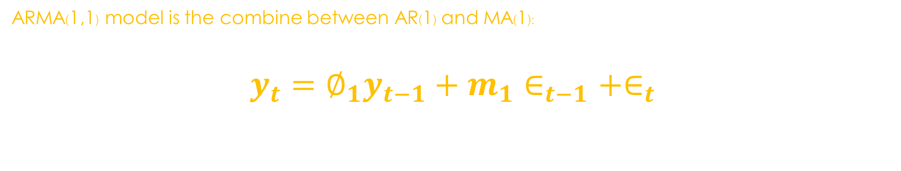
ARMA(Auto regressive Moving Average) Model
ARMA(1,1) model is the combine between AR(1) and MA(1):
$$y_{t}=∅_{1}y_{t−1}+m_{1}∈_{t−1}+∈_{t}$$

Slide 18
ARIMA(Auto Regressive Integrate Moving Average) Model

Slide 19
ARIMA(ARIMA(Auto Regressive Integrated Moving Average) Model
An ARIMA(p,d,q) model is characterized by 3 terms: p, d, q
where,
p is the order of the AR term(same as ARMA model)
d is the number of differencing required to make the time series data into stationary
q is the order of the MA term(same as ARMA model)

Slide 20
Stationary

Slide 21
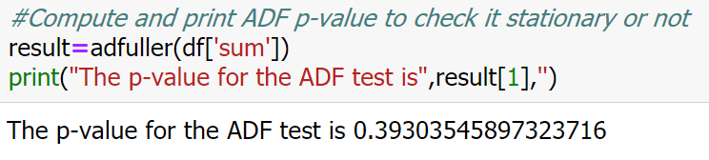
Check stationary with ADF(Augmented Dickey–Fuller)
ADF is a statistical test, where the null hypothesis is that your time series is non-stationary due to trend.
Because P-value > 0.05 we can’t reject null hypothesis so this data is not stationary.

Slide 22
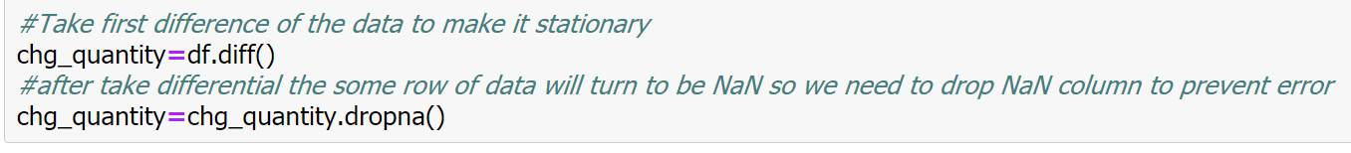
Make it stationary
We can transform this data to make it stationary. The simplest way and normally use it take differential of this data.
After take differential we will check p-value again

Slide 23
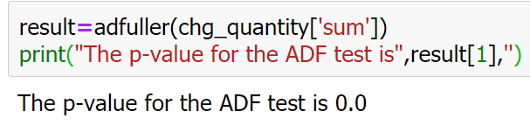
Check P-value again!
As you can see the p-value of this data is 0.0 now it’s less than 0.05 so we can reject hypothesis.

Slide 24
How to choose model?

Slide 25
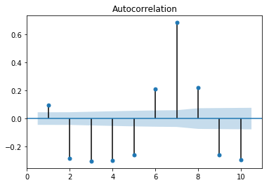
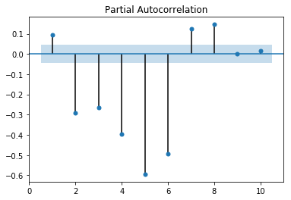
ACF and PACF
 | ACF | PACF
AR(p) | Tails off | Cuts off after lag p
MA(q) | Cuts off after lag q | Tails off
ARMA(p, q) | Tails off | Tails off

Slide 26
How to choose order(p,q)

Slide 27
Information Criteria
Information Criteria:adjusts goodness-of-fit for number of parameters
Two popular adjusted goodness-0f-fit measure are
1.AIC(Akaike Information Criteria)
2.BIC(Bayesian Information Criteria)

Slide 28
AIC(Akaike Information Criteria)

Slide 29
BIC(Bayesion Information Criteria)

Slide 30
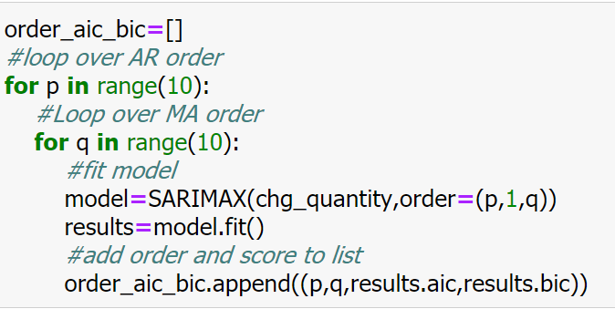
Check values of AIC and BIC
The loop to find p and q in range(0 – 9) the loop will continuously change value of p and q and will be record in the “order_aic_bic”

Slide 31
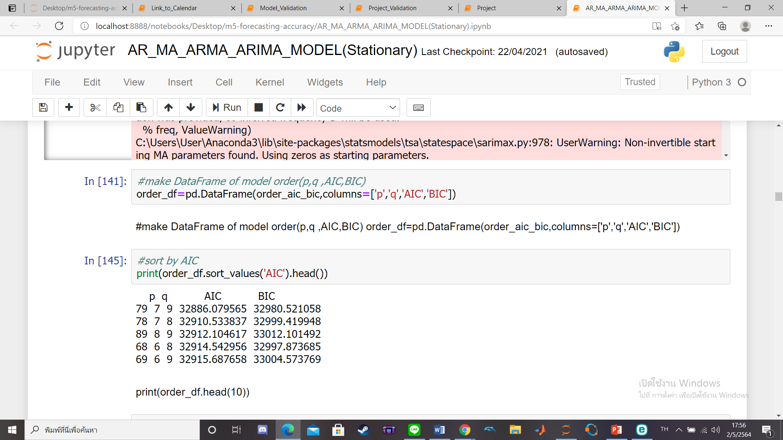
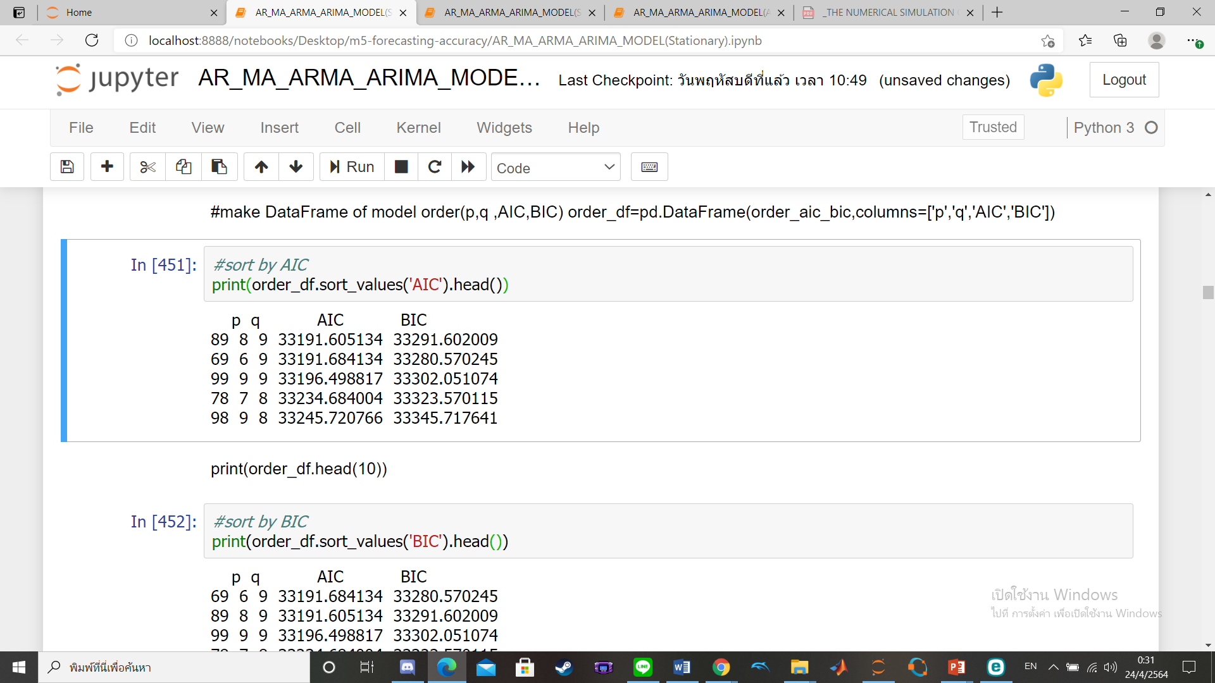
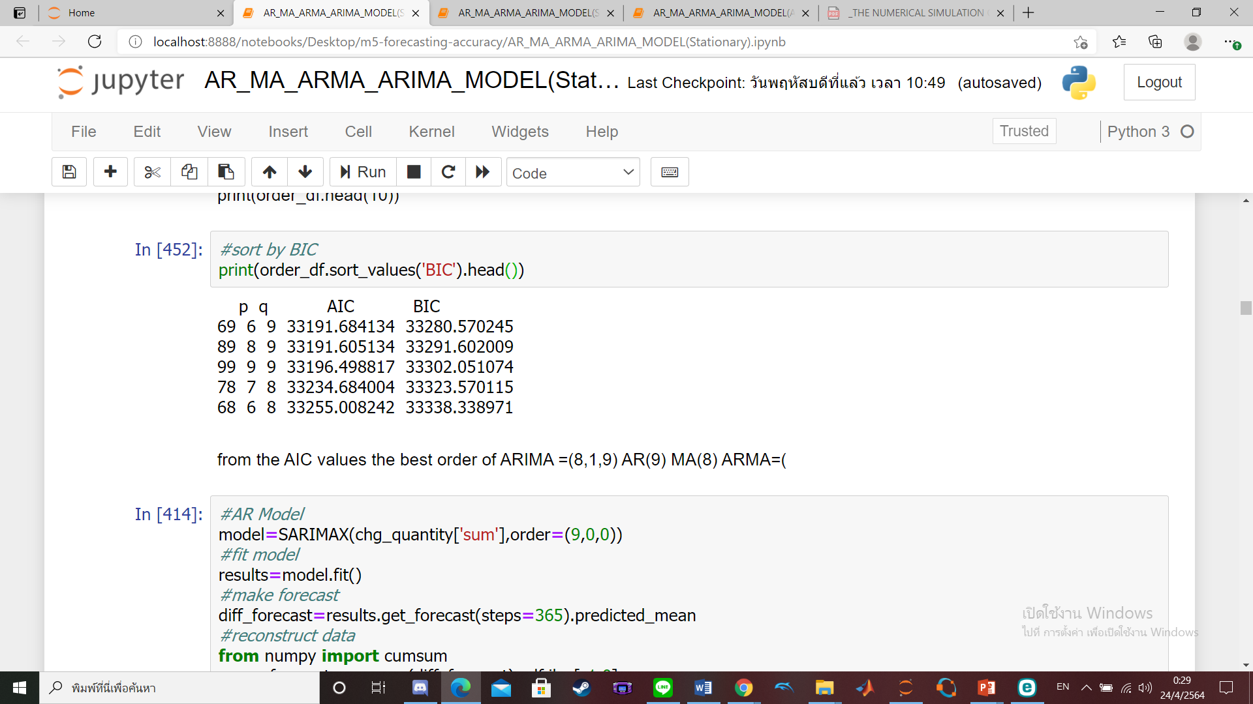
Check and choose values of AIC and BIC
(Make it do DataFrame for easy to use)
Sort values of AIC values from smallest to largest
Sort values of BIC values from smallest to largest

Slide 32
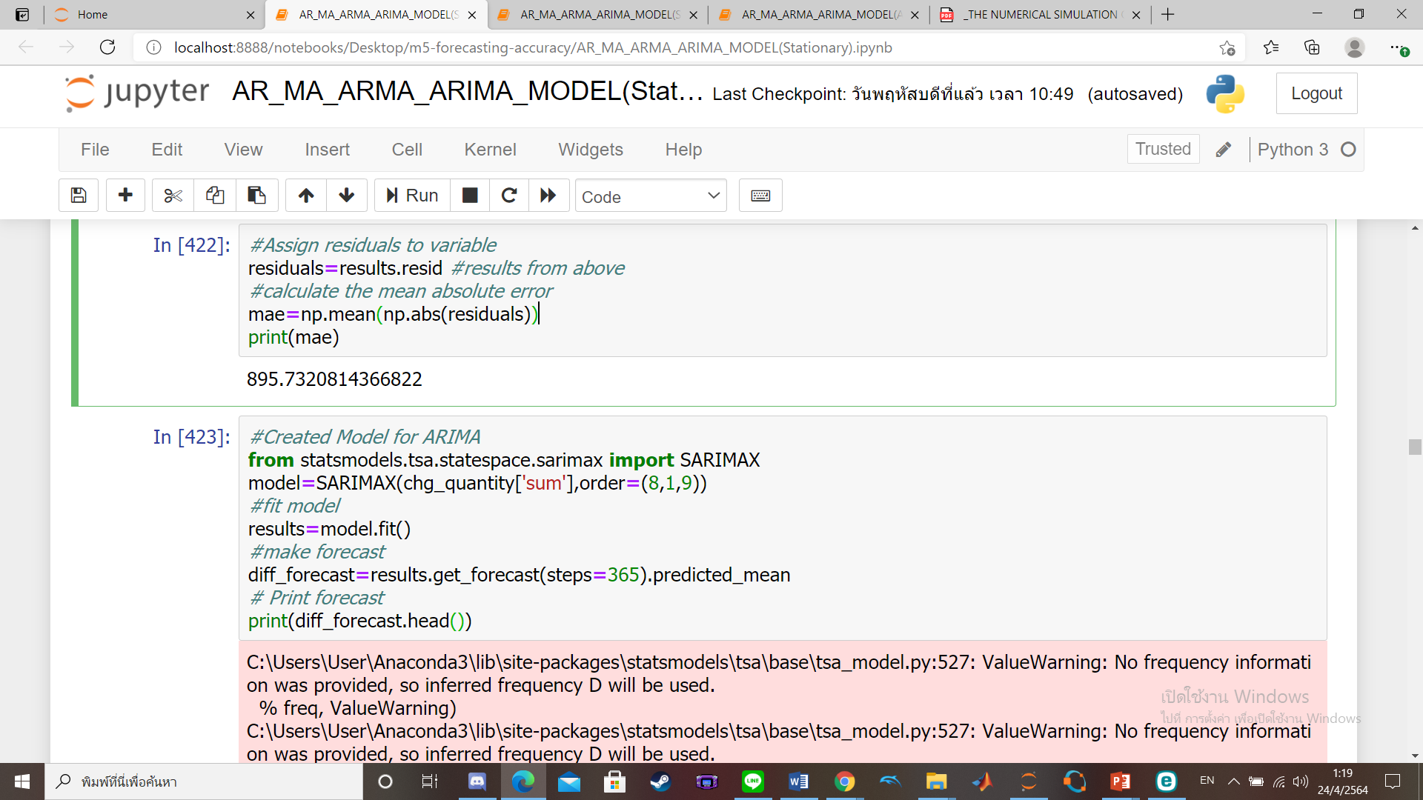
Train model and Predict values
After we know what model is the best so we will use it to train the data.
We fit the model and forecast future steps=365 means predicts next 365 values

Slide 33
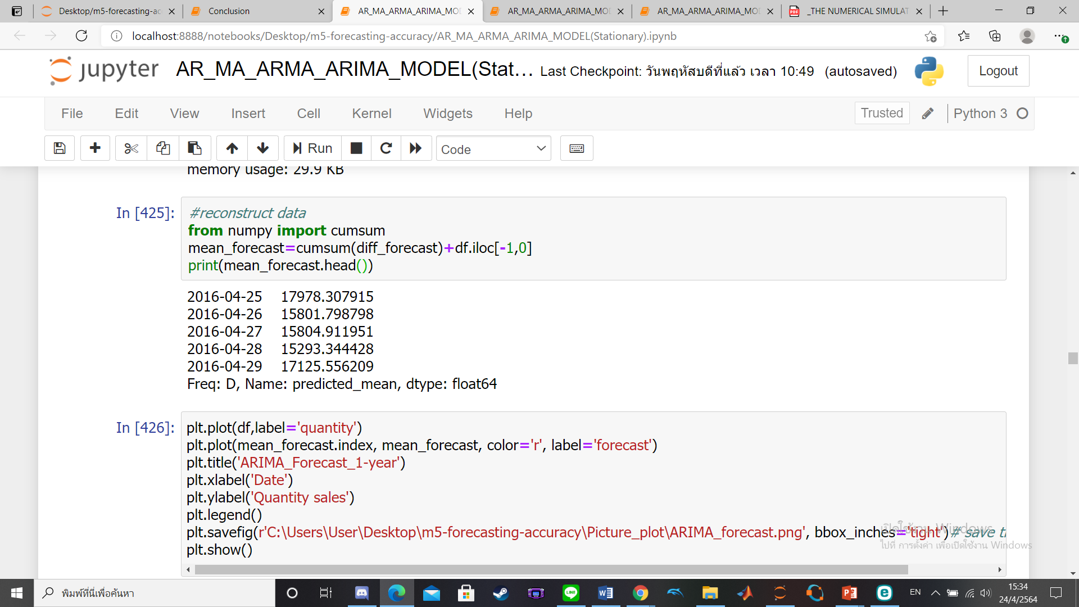
Revert Value
we will use cumsum command to revert data back before differencing values the values that we predicted will return as well

Slide 34
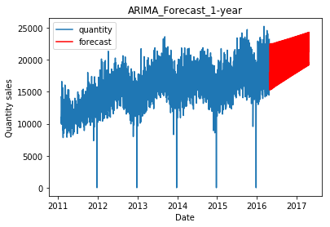
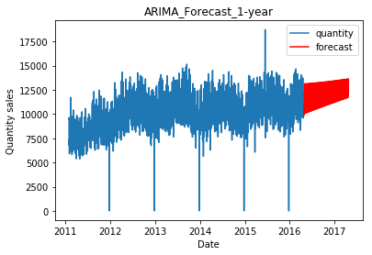
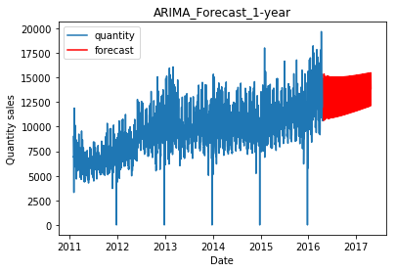
Graph
(CA Data)
(TX Data)
(WI Data)

Slide 35
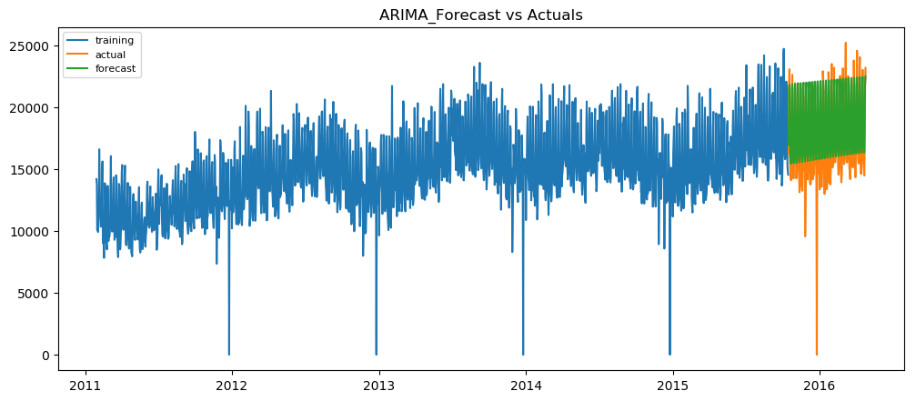
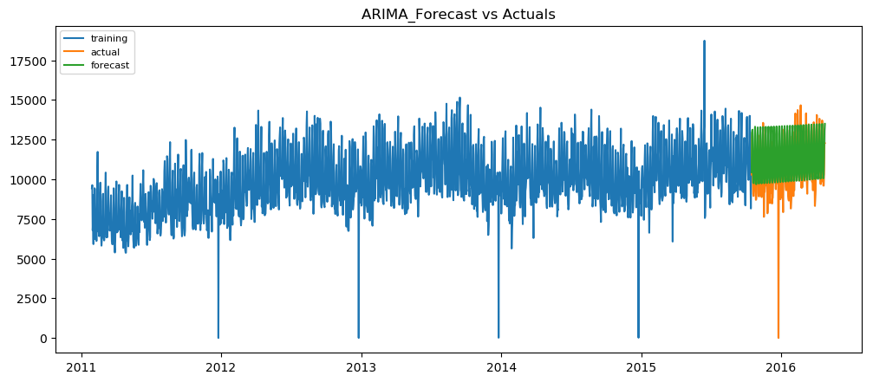
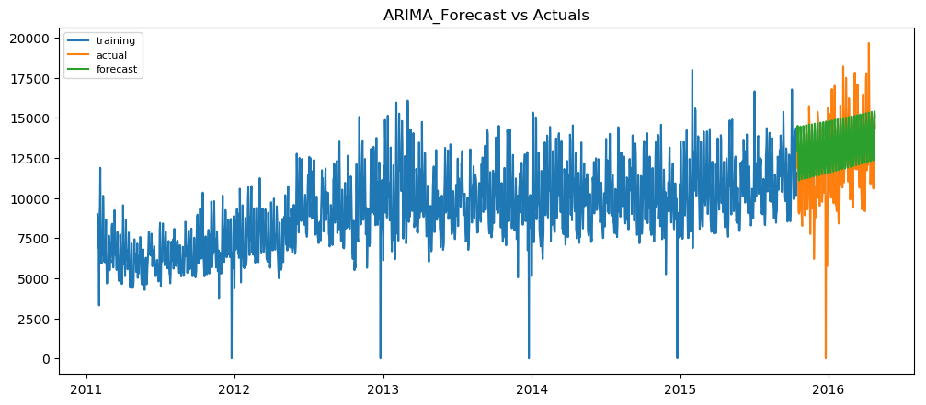
Check Error
CA Data
(Error=1449.6321507882883)
TX Data
(Error=988.7215962144859)
WI Data
(Error=1741.7002631936487)

Slide 36
Thank You

